Slide 1

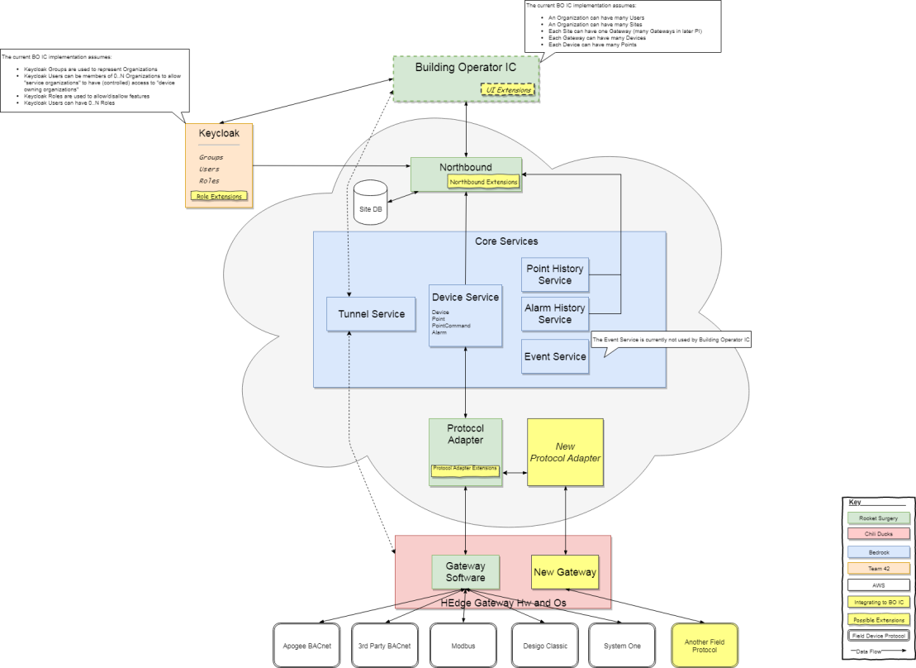
Short project presentation Me, My Project, My personal goals
Project Description
Horizon Cloud provides widespread connectivity to legacy & new controls, 3rd party, IoT,
edge devices and a step-wise covering of on-site, real-time requirements.
Horizon Cloud features its own apps based on building integration framework, along with
themes, with an open API for ecosystem and SSP.
The program also provides a common data model and API to BT Building Integration
Framework to map southbound data against model.
Significant Requirements for Testing
All automated
Tech. Test Lead in 3 projects
Horizon Cloud, single tester
Rest: 5 devs, PO, PL, Arch.
Operations & Management
testers: 3 local, 2 Mumbai, 3 Romania
Rest: 4 local devs, PO, PL, 10+ remote devs
Niagara N4,
Tester: 1 local, 1 remote
Rest: 3devs, PL
All in CI pipeline
High level view / Context diagram
Paradigm-setting best practices need to be applied
Challenges
- Solidify my vague understanding of TeA
- Clarify the delta btwn Test Strategy & TeA
- Understand design for testability, req.
engineering, business models
- Network & look for solutions to
Immediate Challenges ( → )
Measuring and proving the quality and coverage of test automation code.
State-of-the-art industry best practices vs Siemens ways
Context-switching between 3 projects
Notes:
In order to foster networking early I have prepared the following draft of the presentation I will show in workshop one.
You will find the same material physically present throughout the whole week of out first onsite workshop.
Please raise questions/discussions now using this material or the physical copy.
Thank you.

